Slide 1

GALGOTIAS UNIVERSITY
Plot No.2, Sector -17 A, Yamuna Expressway,
Greater Noida, Gautam Buddha Nagar, U.P., India
SCHOOL OF COMPUTING SCIENCE & ENGINEERING
CAT-3 Case Study Report File Submission
Course Name: COMPUTER WORKSHOP
Course Code: BCS01T1004
School: SCSE Year: 1st Semester: 1
Program: B. TECH Session: 2021-2022
Submitted To: | Submitted By:
Mrs. Indravati | AVIRAL GAURAV(21SCSE1300029) ABHINAV KUMAR CHOUDHARY(21SCSE1011615) AMIT SINGH(21SCSE1410106)

Slide 2
Welcome to our
program

Slide 3
QUESTION:-
When visiting an insane asylum, I asked two inmates to give their ages. They did so, and then, to test their arithmetical powers, I asked them to add the two ages together. One gave me 44 as the answer, and the other gave 1,280. I immediately saw that the first had subtracted one age from the other, while the second person had multiplied them together. What were their ages?

Slide 4
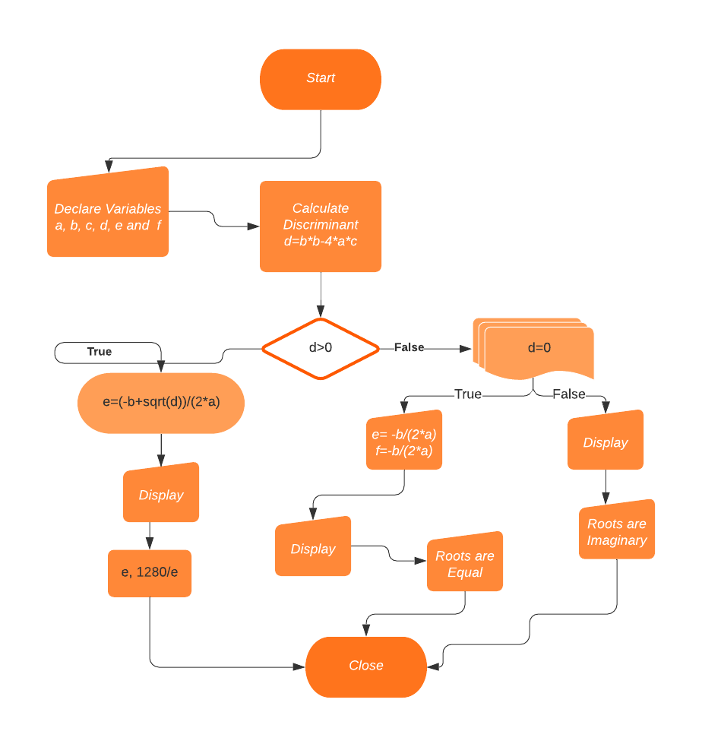
FLOW CHART:-

Slide 5
PROGRAM:-
#include<stdio.h>
#include<math.h>
int main()
{
printf("Let the age of the 1st inmate is x\n");
printf("and let the age of the second inmate is y\n");
printf("First has substracted the ages so the
equation:\n x-y=44 ......(1)\n");
printf("Second has multiplied the ages so the
equation:\n x*y=1280 ......(2)\n");
printf("On Simplifying the both equations we
get:\n x*x-44x-1280=0 ........(3)\n");

Slide 6
float a,b,c,d,e,f;
printf("Enter the value of coefficient a, b and c from the
equation (3)\n=");
scanf("%f %f %f", &a, &b, &c);
d=b*b-4*a*c;
e=sqrt(d);
if (d>0)
{
e=(-b+sqrt(d))/(2*a); // applying Sridharacharya Formula
// ignoring (-b-sqrt(d))/(2*a) because age cannot be negative
printf("\n\n");
printf("The Age of first inmate is = %f\n",e);
printf("The Age of second inmate is = %f\n",1280/e);
}
else

Slide 7
END OF THE PROGRAM
if (d==0)
{
e=-b/(2*a);
f=-b/(2*a);
printf("The root are equal = %f",e,f);
}
else
printf("Roots are imaginary");
return 0;
}

Slide 8
OUTPUT :-
Let the age of the 1st inmate is x
and let the age of the second inmate is y
First has subtracted the ages, so the equation:
x-y=44 ......(1)
Second has multiplied the ages, so the equation:
x*y=1280 ......(2)
On Simplifying the both equations we get:
x*x-44x-1280=0 ........(3)
Enter the value of coefficient a, b and c from the equation (3)
=1 -44 -1280
The Age of first inmate is = 64.000000
The Age of second inmate is = 20.000000

Slide 9
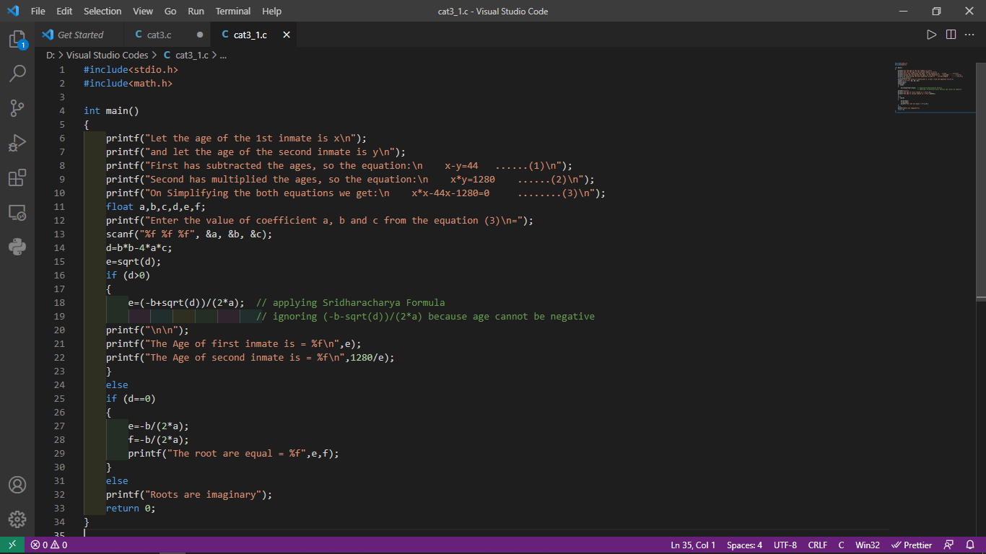
CODES IN VISUAL STUDIO CODE:-

Slide 10
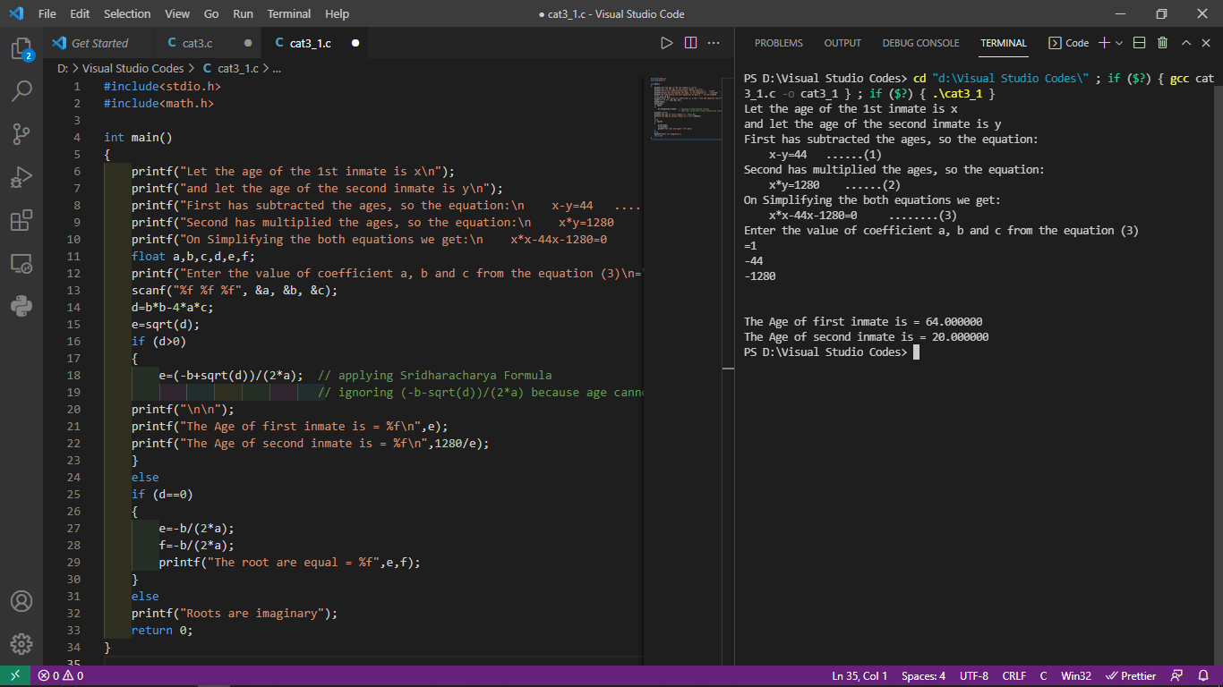
OUTPUT OF THE PROGRAM:-

Slide 11
THANKING YOU!!

